Slide 1

The Citicorp Building Case Ethics in Engineering Prepared by: Nadia Thaer, Rasha Daoud

Slide 2
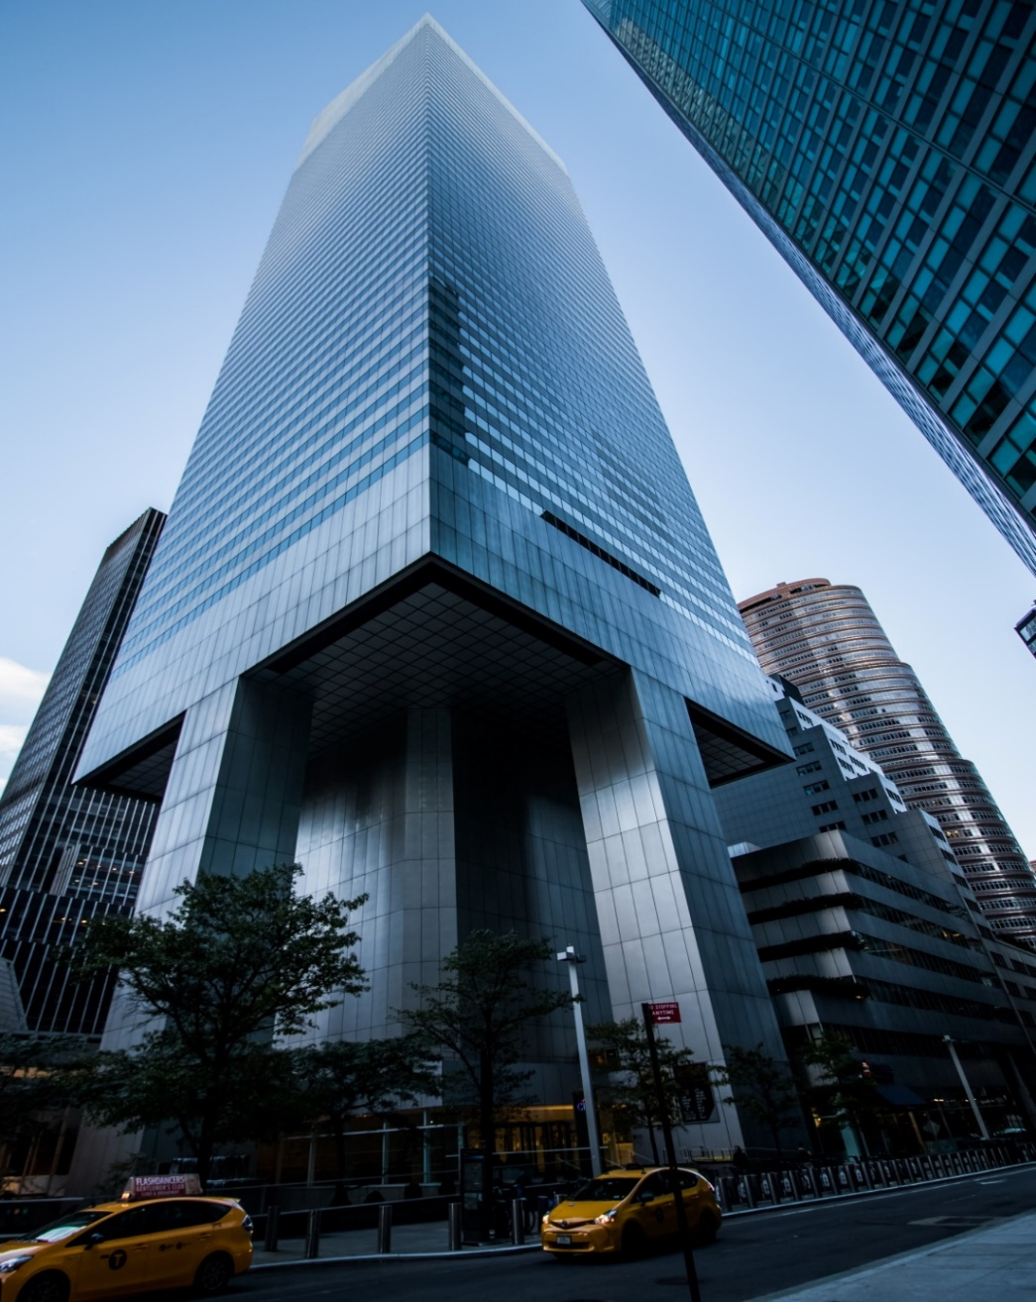
What Happened in 1978 ? - The Citicorp Building was built in 1977 in New York. - Designed by engineer William LeMessurier. - The building’s unique design used four stilts for support.

Slide 3
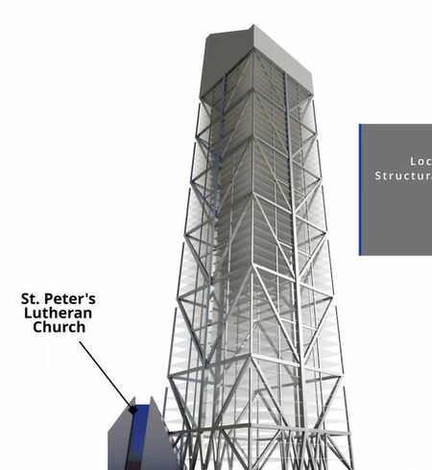
Why they use a unique design? - St. Peter’s Lutheran Church was located on the building site. - In order to build the skyscraper next to St. Peter's Lutheran Church, they set a condition that no columns would pass through the new church.

Slide 4
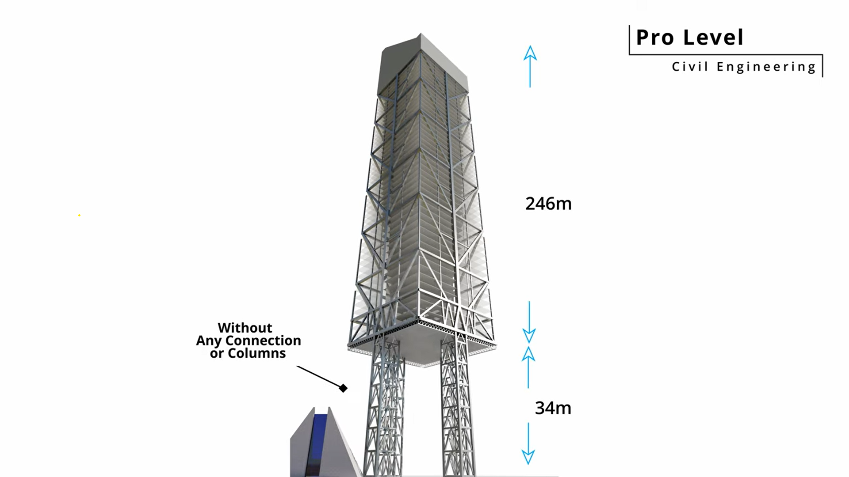
Solution :
To solve this, the engineers designed the building to stand on four stilts
but instead of placing them at the corners like usual, they put the stilts in the middle of each side of the building.
This way, they could avoid tearing down the church.

Slide 5
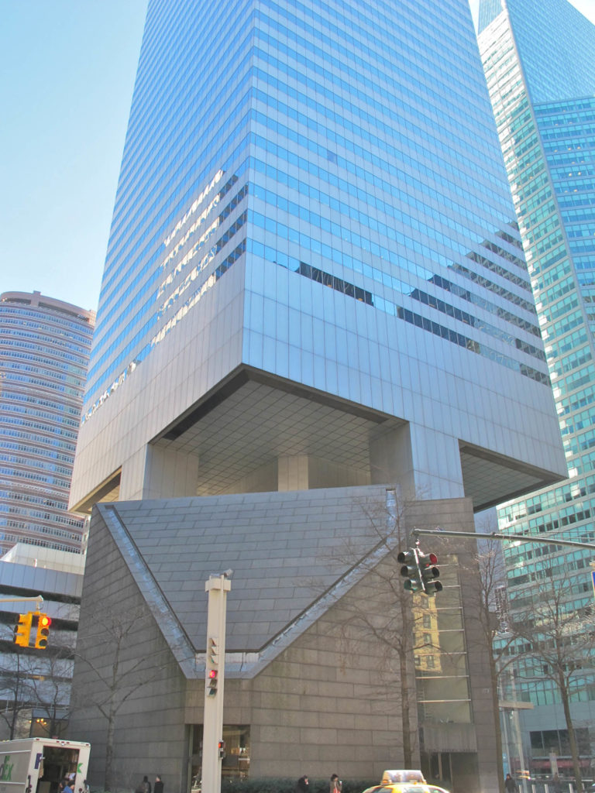
Effect on Pillar Placement: - This unusual placement made the building less stable against strong winds, especially during hurricanes. - The diagonal winds could create dangerous swaying or even collapse without proper support.

Slide 6
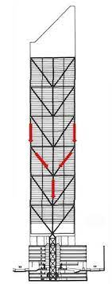
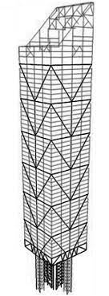
Inverted Chevron Braces: - Engineers used a special "V"-shaped (chevron) structure inside the building. - These braces helped direct the weight of the building from the stilts towards the center, then down to the ground.

Slide 7


- In June 1978, a question from an engineering student made William rethink about his design. - William’s new calculations showed surprising results. - Under certain wind conditions, the braces (supports) would face 40% more force than expected. - This extra force exposed a serious weakness in the building’s structure.

Slide 8
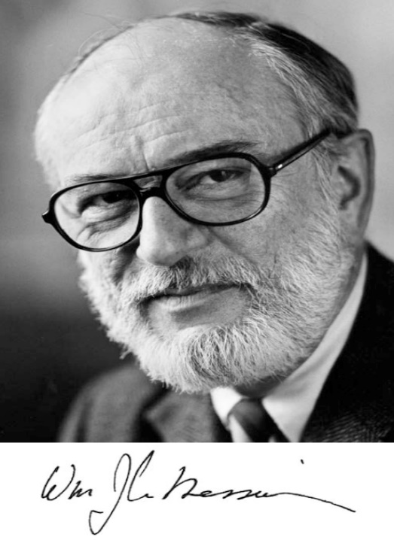
Who are the actors?
Design Team: Architect Engineer : Hugh Stubbins &Son.
Structural Engineer :William LeMessurier
Citicorp : Building owner.
Diane Hartley : Architecture student who found a design problem.

Slide 9
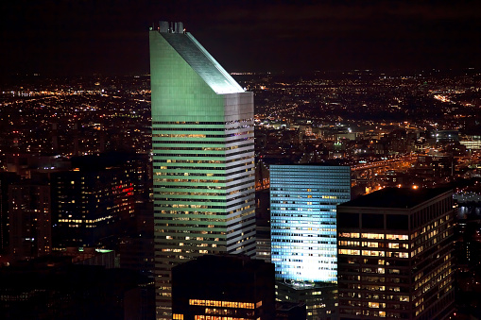
The ethical dilemma for Citicorp Center
-The ethical dilemma involved safety concerns regarding the building's stability.
-Engineers faced a decision on whether to disclose the structural issues publicly or handle them quietly.

Slide 10
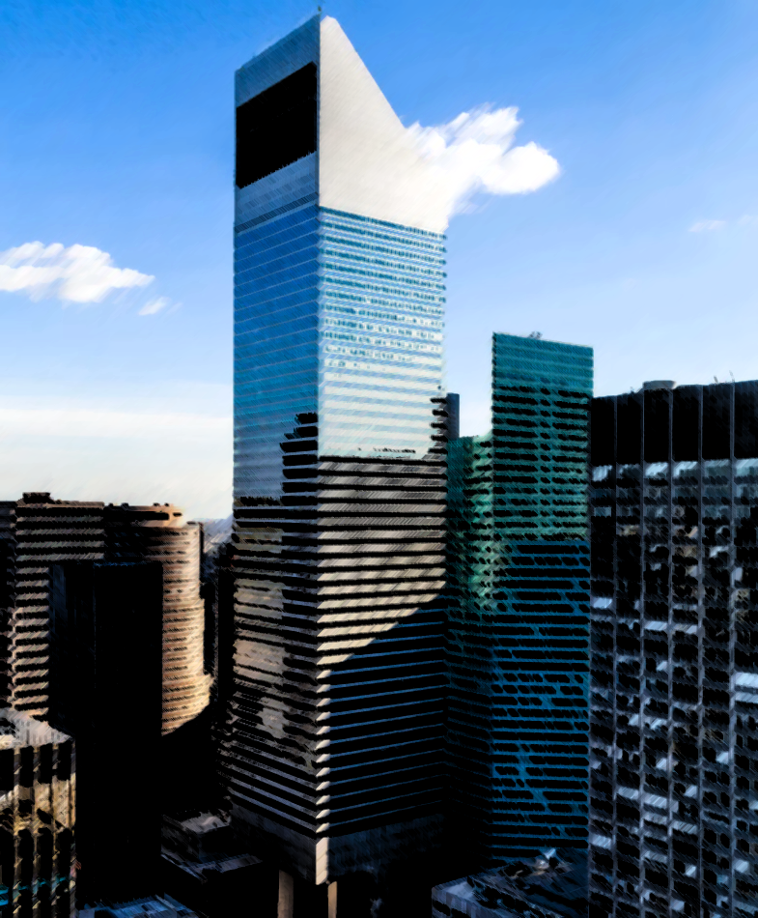
Importance of the Citicorp Building Case: -Highlights the ethical responsibilities of engineers. -Shows why transparency and safety matter in large public projects.

Slide 11
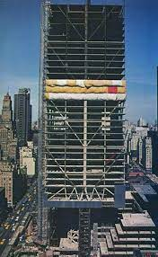
Ethical Issues Raised: -Balancing public safety with repair costs. -The need for honesty when flaws are found. -Ensuring engineers act to protect the public.

Slide 12
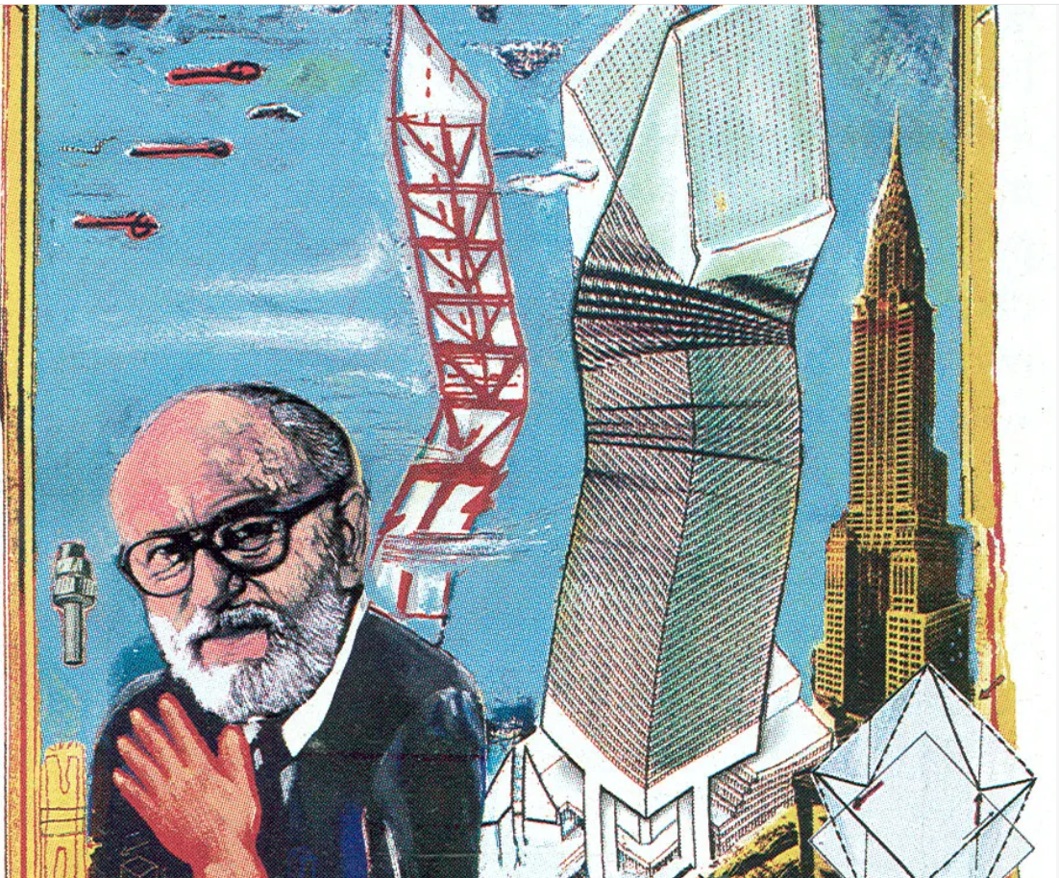
How Was It Handled? - LeMessurier took action as soon as he discovered the problem. - He worked with Citicorp to discreetly fix the building's structure.

Slide 13
Concerns:
The building posed a risk that could have led to injuries.
The public wasn’t informed during the repair work.

Slide 14
What Could Have Been Done Better?
Better Planning.
Greater Transparency.
Earlier Communication.

